Slide 1
Lecture 10 – Logistic Regression (Part 2)
Instructor: Hamed Hasheminia

Slide 2
Agenda
Unbalanced observations and Logistic Regression
FP/FN/TP/TN/FPR/TPR
The effect of changing Threshold
ROC curves
Area Under Curve
How to compare classification algorithms

Slide 3
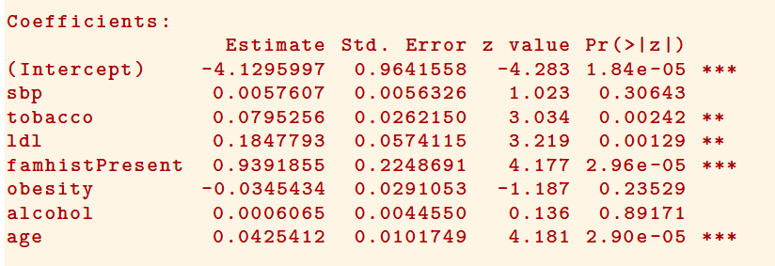
Quiz - How do we interpret this?

Slide 4
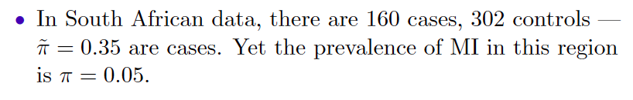
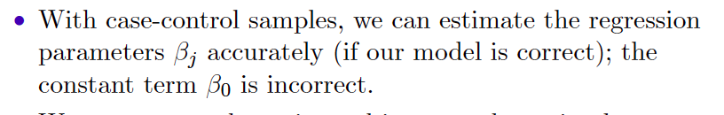
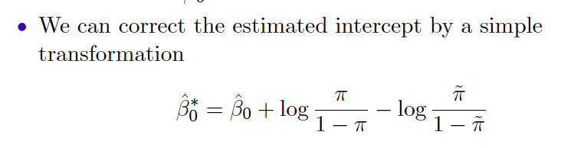
Case-Control Sampling and Logistic Regression

Slide 5
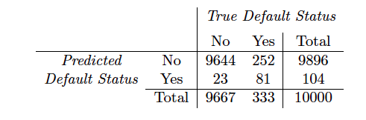
Credit Data
(23 + 252)/10000 errors – a 2.75% misclassification rate! Is it good?
Some caveats
This is training error, and we may be over-fitting. But this is not a big concern in this case since n = 10000 and we only used 4 parameters.
If we classify everything as No – then we make only 3.33% error.
Of the true No’s, we make 23/9667 = 0.2% errors; of the true Yes’s, we make 242/333 = 75.7% errors!
Notes:
If model is gets accuracy too low, then change the threshold for setting the result.

Slide 6
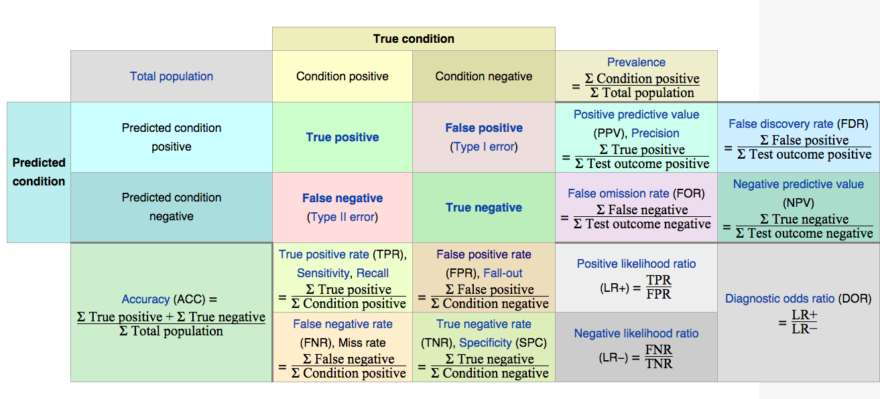
Notes:
Type 1 and Type 2 error or alpha and beta.

Slide 7
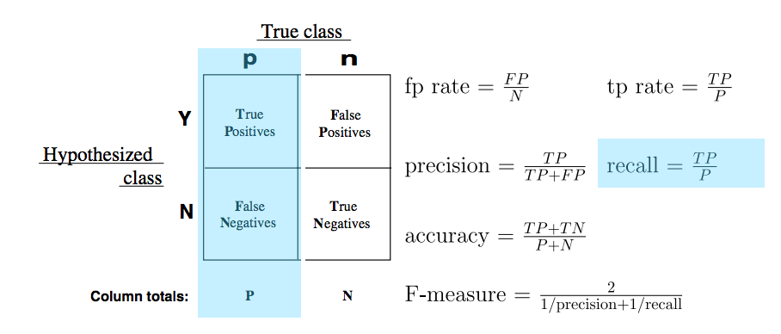
Recall or Sensitivity
Imagine predicting a marble color either green or red. There are 10 of each. If the model identifies 8 of the green marbles as green, the recall, or sensitivity, is .8. However, this says nothing about the number of red marbles that are also identified as green.

Slide 8
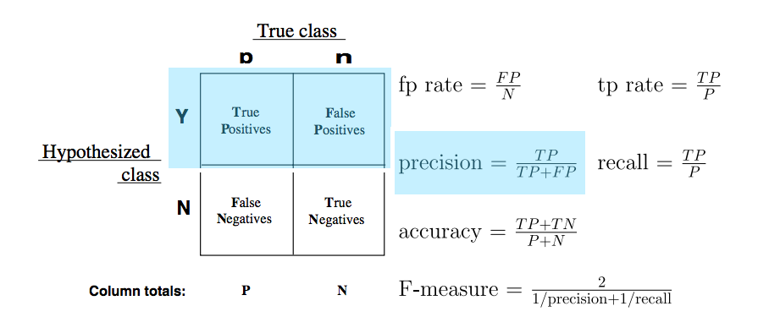
Precision
Imagine predicting a marble color either green or red. There are 10 of each. If the model identifies 8 of the green marbles as green, the recall, or sensitivity, is .8. However, this says nothing about the number of red marbles that are also identified as green.

Slide 9
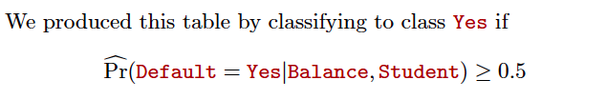
Credit Data - continues
False Negative Ratio =75.7% , False Positive Rate = 0.2%

Slide 10
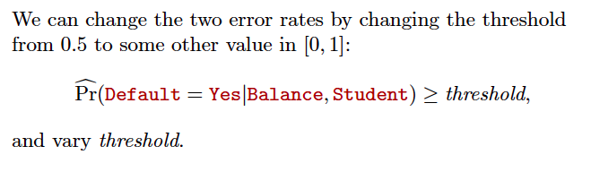
Changing Threshold

Slide 11
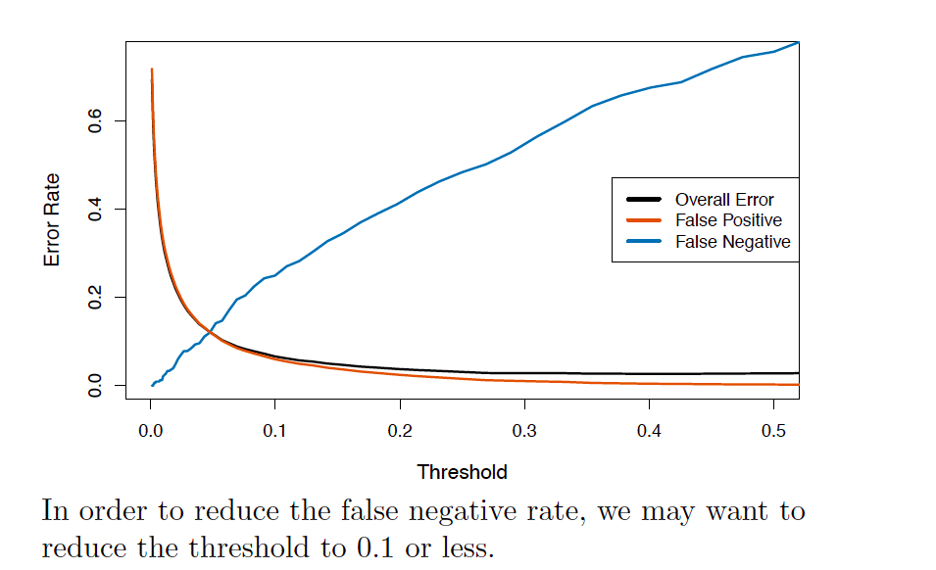
Varying the Threshold

Slide 12
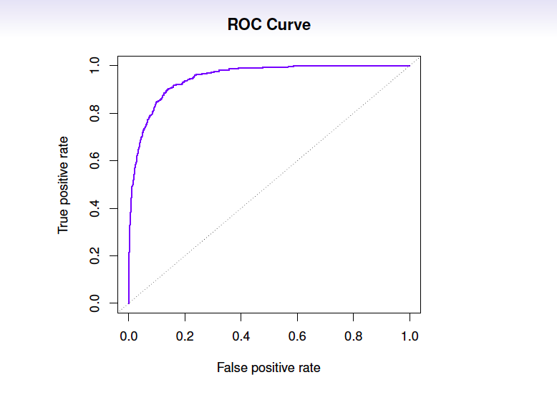
ROC Curve

Slide 13
Let’s explore ROC
http://www.navan.name/roc/
After Instructor’s instructions please team-up with with another student and explain ROC to each other.

Slide 14
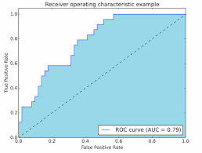
Area Under Curve (AUC)
One of the measures used to evaluate Classification Algorithms is Area Under Cure (AUC) of ROC.
Usually the model which has the largest AUC is considered the best classification model.
AUC is a number between (0.5 and 1). Why couldn’t it be less than 0.5?

Slide 15
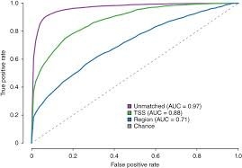
Which Classification Model is better?

Slide 16
Summary
How to adjust Logistic Regression coefficients for unbalanced data
FP/FN/TP/TN/FPR/TPR
How changing Threshold can change FPR/TPR/FNR/TNR
What ROC curves mean
How to calculate Area Under Curve
How to compare classification algorithms using AUC

